Slide 1


RECEIPT AND INVOICE DIGITIZER
Presented By-
GajendraRajpoot
Shivangi Bhargava
Divya Sri Yaganti​​​

Slide 2

PROBLEM STATEMENT
Businesses manage many paper receipts & invoices.
Manual entry is time-consuming and error-prone.
Receipts can be lost or damaged.
Hard to search and analyze expenses.

Slide 3

PROPOSED SOLUTION
A system that:
Scans receipts & invoices
Extracts text using OCR
Identifies key data automatically
Stores digital records
Provides analytics & reports

Slide 4
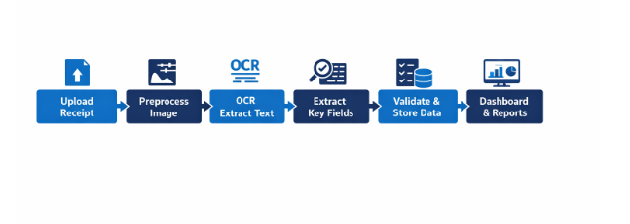
PROJECT OBJECTIVES AND WORKFLOW
Automates data extraction
Reduces manual effort
Ensures accurate storage
Enables quick search & retrieval
Provides expense insights

Slide 5
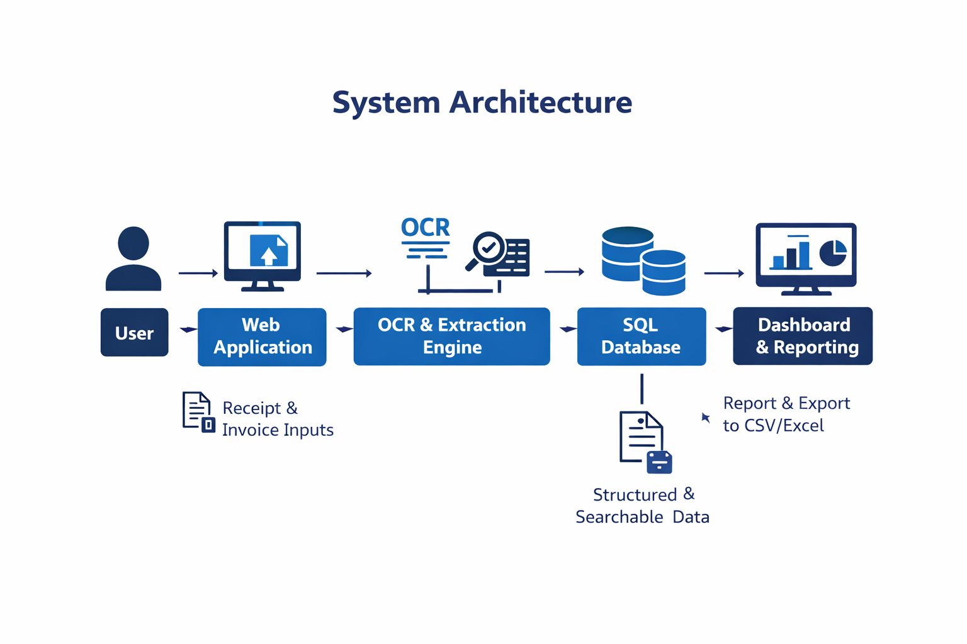

Slide 6
MILESTONE-1
Document Ingestion & OCR
Objectives
Upload receipts (PDF, JPG, PNG)
Preprocess images
Extract text using OCR
Techologies Used
Python
OpenCV / Pillow (image preprocessing)
Tesseract OCR / Groq API
Explanation
Receipts are uploaded and enhanced for clarity. OCR converts images into machine-readable text.

Slide 7
MILESTONE-2
FIELD EXTRACTION & VALIDATION
Objectives
Extract vendor, date, totals, tax
Validate totals & detect duplicates
Store structured data
Technologies Used
Python Regex
NLP techniques
Pandas (data structuring)
Hashing algorithms (duplicate detection)
Explanation
Regex & NLP extract key fields. Validation ensures correct totals and removes duplicates.

Slide 8
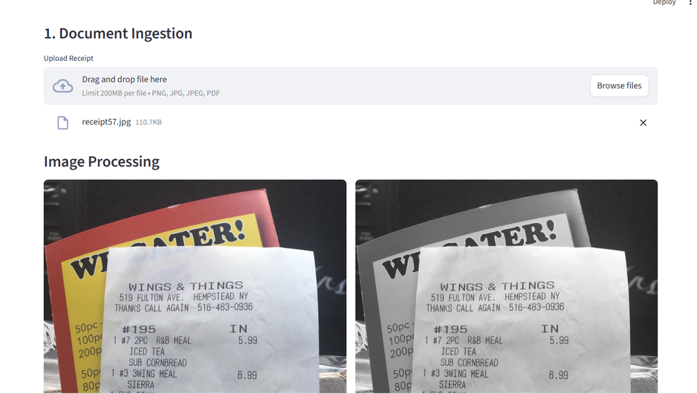
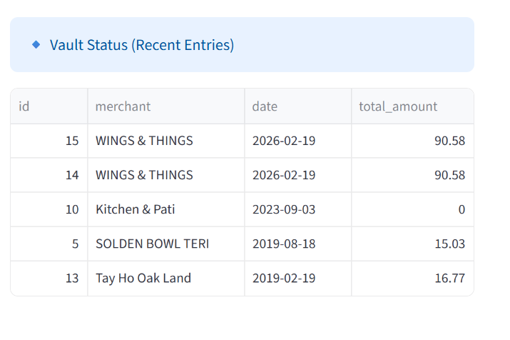
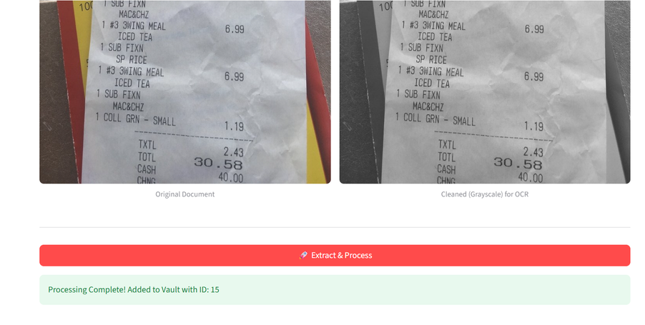
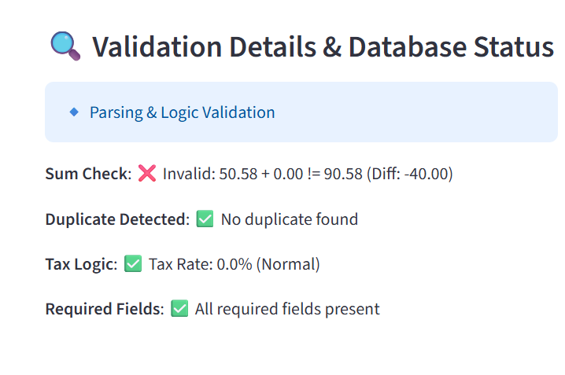
Outcomes of Milestone 1 and 2

Slide 9
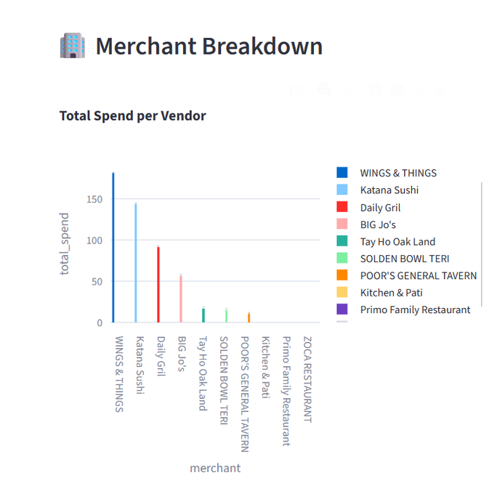
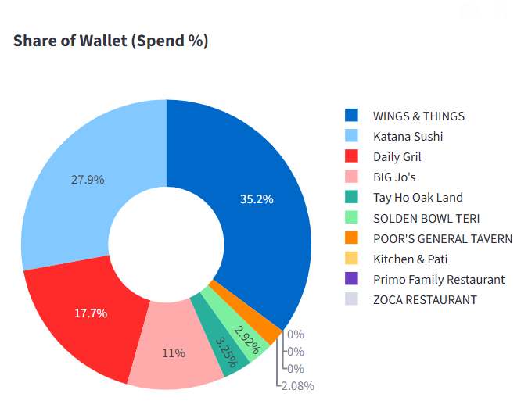
MILESTONE-3
DASHBOARD & REPORTING
Objectives
Build user dashboard
Export reports (CSV/Excel)
Show spending analytics
Technologies Used
Streamlit / Flask
Pandas
Matplotlib / Plotly (charts & analytics)
Explanation
Dashboard allows users to review receipts, download reports, and view expense insights.

Slide 10
MILESTONE-4
POLISHING & INTEGRATION
Objectives
Improve extraction accuracy
Add search & filter
Optimize database performance
Technologies Used
Template-based parsing
SQL indexing & query optimization
Caching techniques
Explanation
Template parsing improves accuracy. Search & optimization enhance performance and usability.

Slide 11
CONCLUSION
The Receipt & Invoice Digitizer simplifies receipt management by turning paper documents into organized digital data.
It saves time, reduces errors, and provides clear expense insights through an easy-to-use dashboard.
This project demonstrates how technology can solve real-world problems and improve efficiency.

Slide 12
THANK YOU

